Slide 1
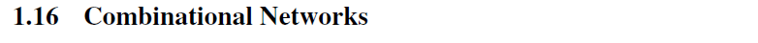
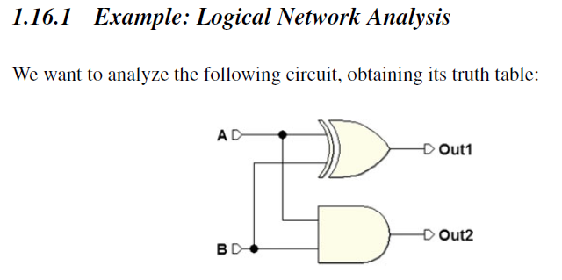
A combinational network is defined as a logical circuit whose output depends only on the combination of its inputs.
A combinational network can be described in terms of a Boolean function.
Some examples of combinational networks:

Slide 2
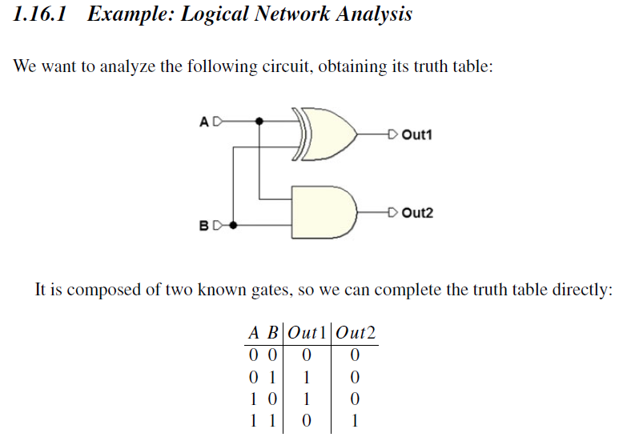

Slide 3
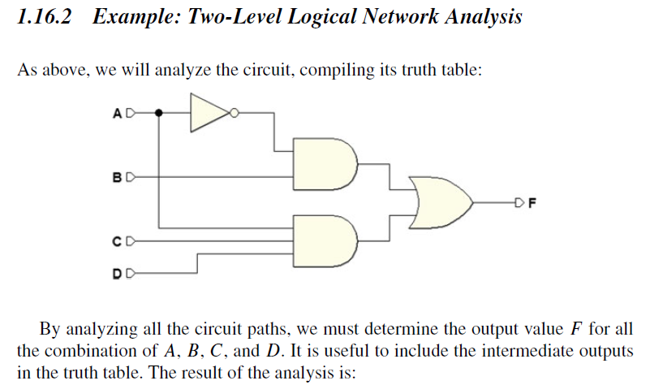
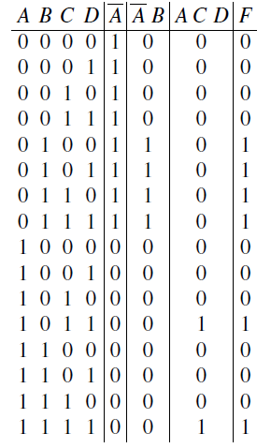

Slide 4
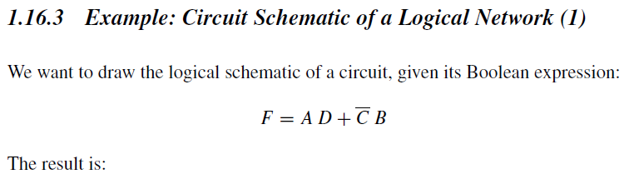
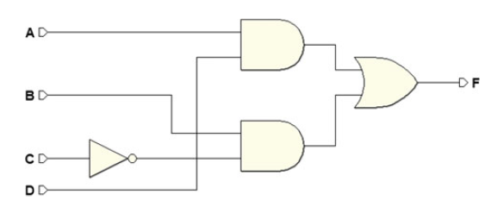

Slide 5
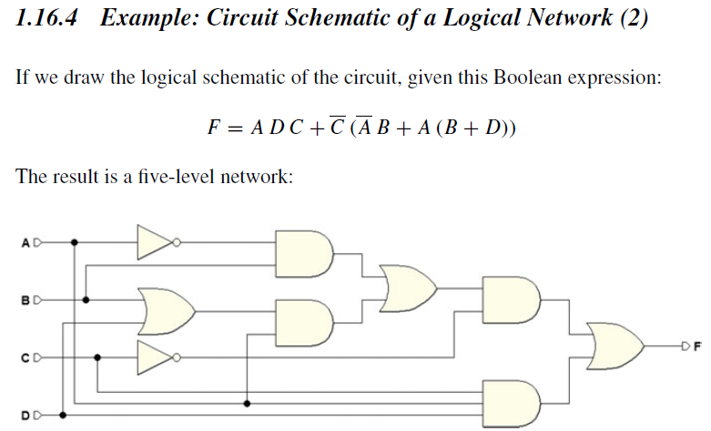
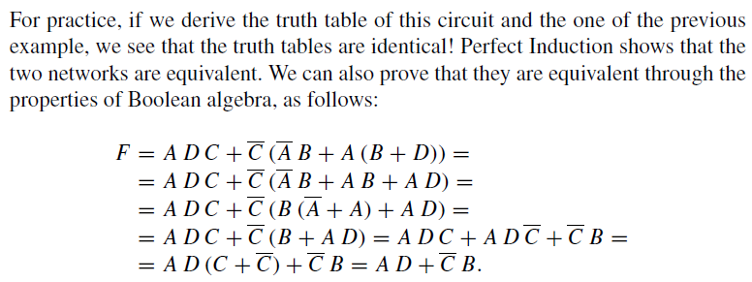

Slide 6
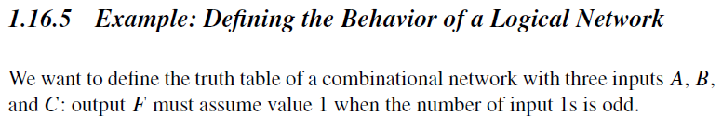
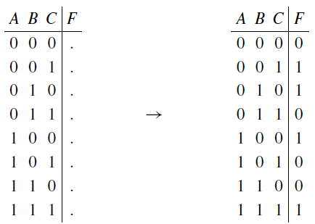
First, we prepare the truth table. Then, line by line, we count the 1s and write the value of F based on the given definition.
For example, in the last line we count three (an odd number of) 1s so we insert a 1 in the output column. In the end, we get the table at the right:

Slide 7
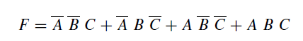
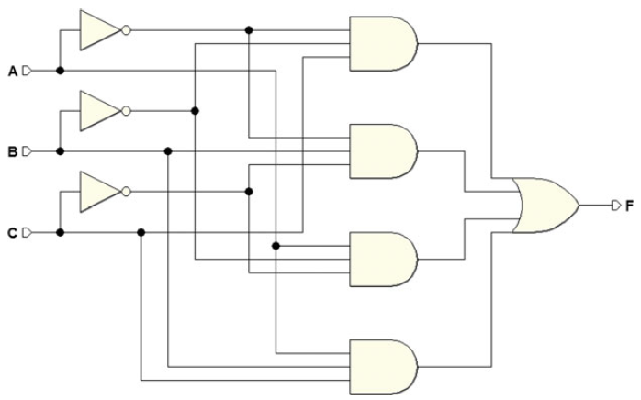
Let’s examine the table derived from the last example and start by writing the Boolean expression of the function using the first form (AND–OR) of Shannon’s Theorem. Then, we’ll draw its circuit schematic. We obtain the following from the table:
The expression defines four three-input ANDs that merge into one single four-input OR. In the end, we get:

Slide 8
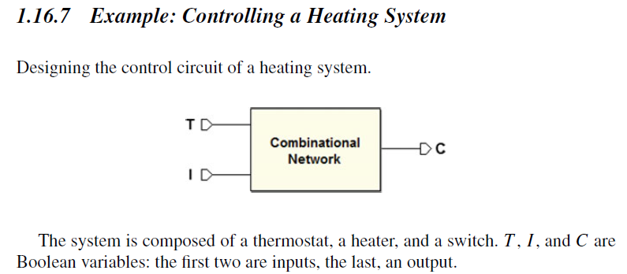
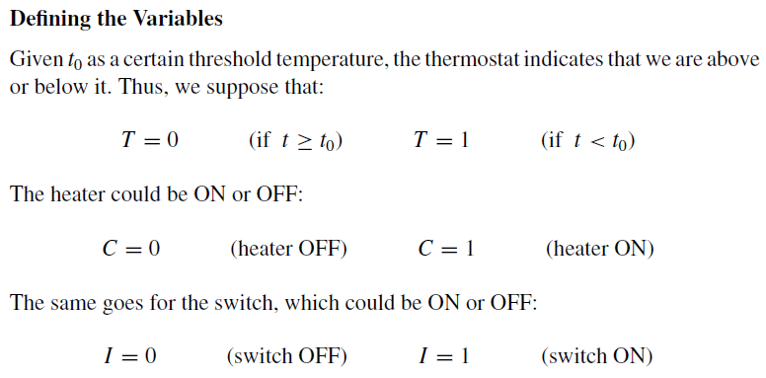

Slide 9
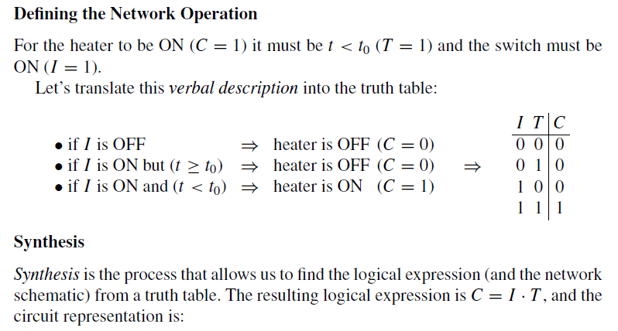


Slide 10
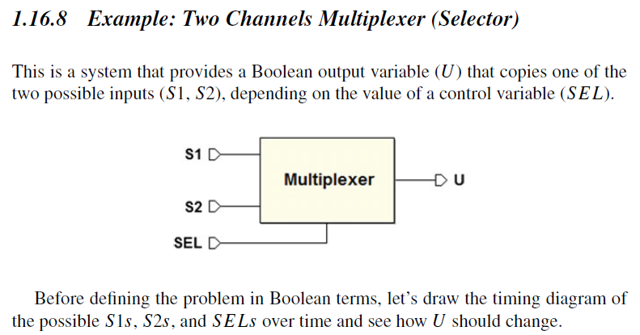
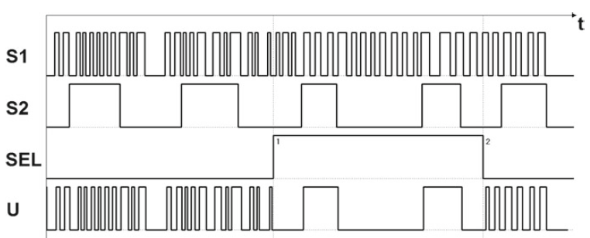
Let’s represent S1 and S2 as digital signals, that is, sequences of 0s and 1s that vary over time and encode information such as a phone call or a TV program, let’s use SEL to select which of the signals will be routed to output U.

Slide 11
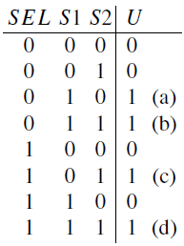
From the image above, we see that U needs to assume the values of S1 if SEL = 0, or of S2 if SEL = 1. Thus, it is possible to define the truth table. Notice that the table is valid “moment by moment,” and does not describe the history of the network operations:

Slide 12
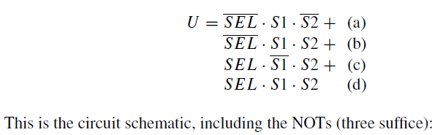
Let’s apply the first form of Shannon’s Expansion Theorem: meaning, let’s do an AND–OR canonical synthesis. For all the 1s in the output column, let’s write the corresponding minterms, merging them in OR:

Slide 13
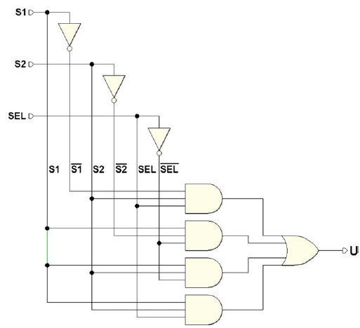
Notice that every time we see one of the four combinations that the table assigns at 1, only the corresponding minterm generates a 1.
The OR makes it so that the output U goes to 1 for all four combinations above.

Slide 14
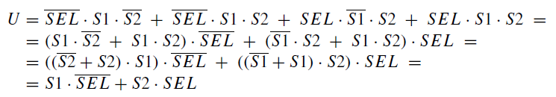


Minimizing
The AND/OR canonical form that we derived can be minimized by using the properties of Boolean algebra. We need to minimize the number of literals of the expression that describes the network. Let’s see the following:
Originally the expression had 12 literals; now it only has four. The network’s complexity is markedly reduced:

Slide 15
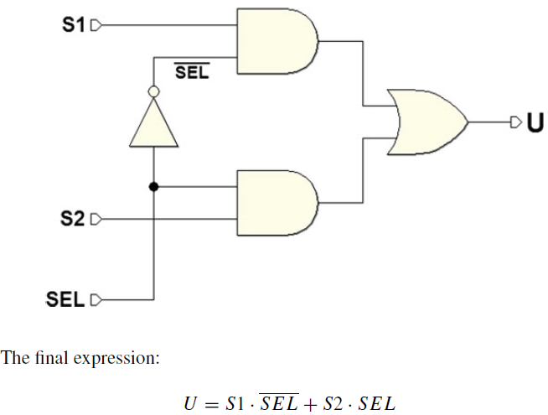
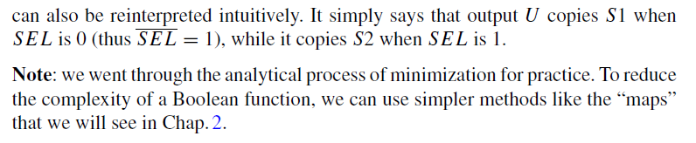

Slide 16





Slide 17
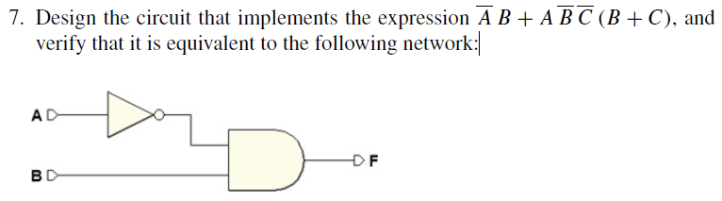
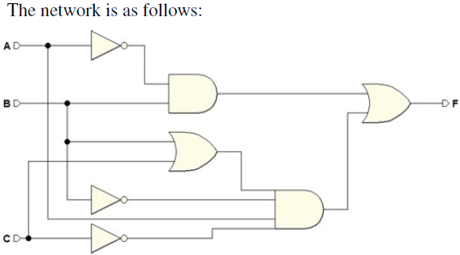
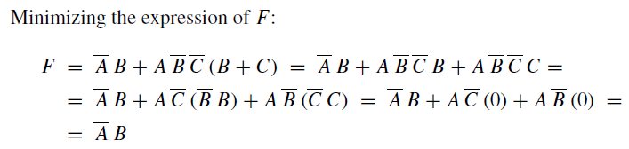

Slide 18

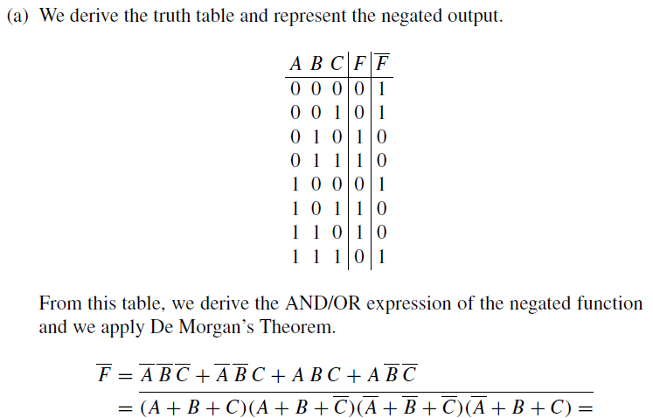


Slide 19


In Chap. 1, we described a logical network with: 1-Boolean expressions and 2-truth tables.
Here, we will see a third lone: 3-maps.
Maps offer a way to write truth tables in a format that makes simplification easier. As we will see, maps order and highlight minterms because they have a geometric structure that makes applying the absorption and logic adjacency properties easy.

Slide 20
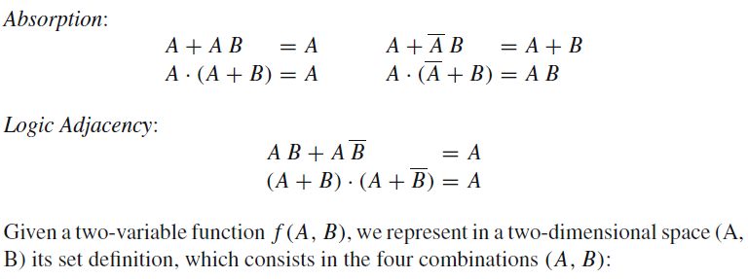
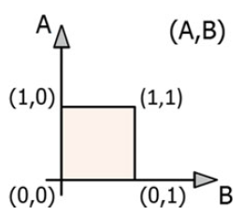

Slide 21

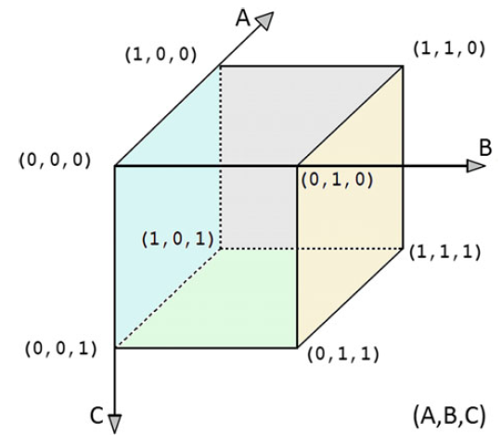
By moving along one edge of the cube from one vertex to another, geometrically adjacent one, we see that only one variable changes value.
There is logic adjacency between two combinations of variables when they are at distance 1; that is, they differ by only one variable.

Slide 22
The cube above is an order-3 cube. Within its structure, various sub-cubes can be identified. The order is the number of geometrical dimensions:
A square is an “order-2” (two-dimensional) cube; an n-order cube will have 2ⁿ vertexes.

Slide 23
In the cube above, we see:
Eight vertexes: Every vertex has one single combination of all the variables; for example, in the vertex (1,1,1) all the input variables have the value 1.
Twelve edges: Each edge has two combinations of variables at distance 1; for example, the upper left-hand edge of the figure is defined by B = 0 and C = 1.
Six faces: Each face has four different combinations of variables; for example, the farthest right face in the figure is defined by B = 1.

Slide 24
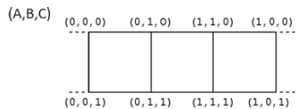
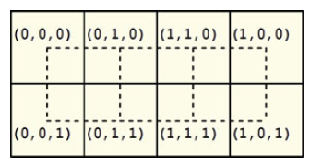
Let’s draw the map corresponding to a three-dimensional cube by “cutting it out” and arranging its eight vertexes on a plane, maintaining as much as possible the same position they had in space.
The map is a lattice of cells, each containing one of the vertexes:

Slide 25
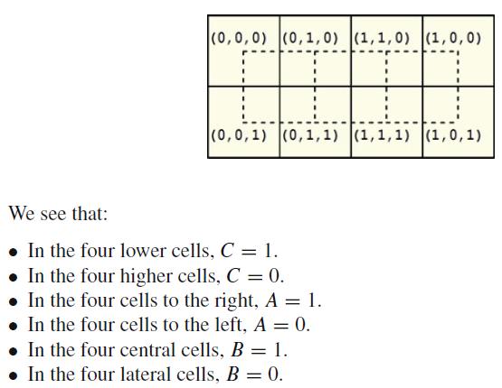
So, we can represent the areas of the map by using the variables as the “coordinates” of the cells.

Slide 26
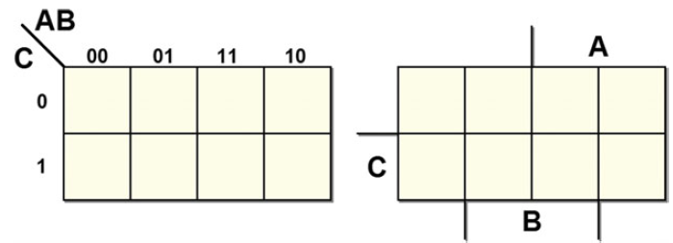
The figure below divides the map into geometrical areas corresponding to the values of the variables. This is the method we will use. These types of maps are called Karnaugh maps (or K-maps).
The name of each variable is drawn in correspondence with the area where it equals 1.

Slide 27
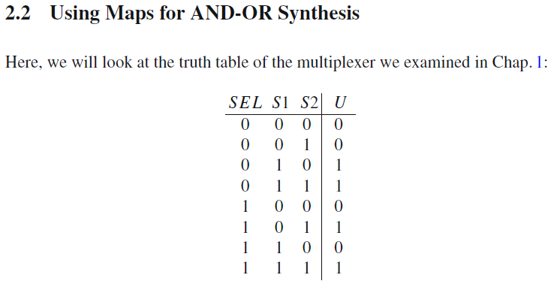
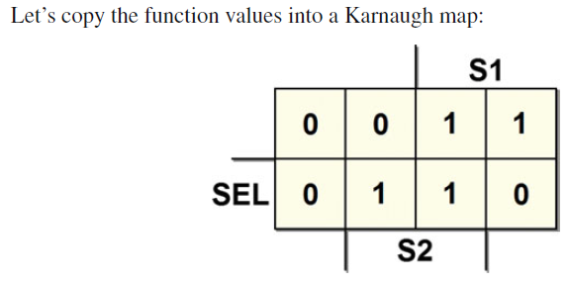

Slide 28
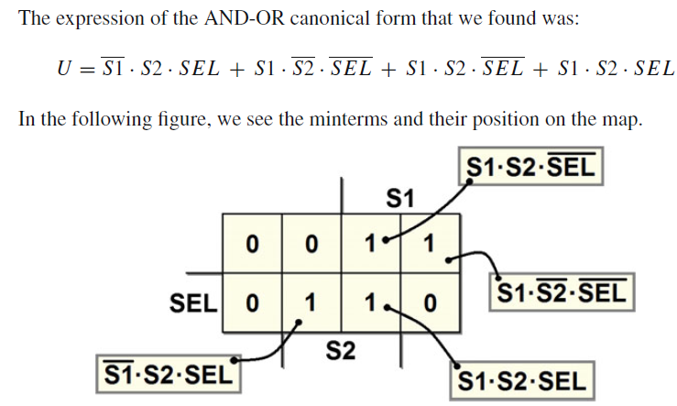
00
01
11
10
0
1

Slide 29
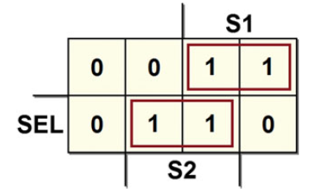
Remember that cells are adjacent if they are at distance 1, that is if they differ by one variable only.
**On the map, we can group together the 1s that are at distance 1 in two unidimensional subcubes (or “groupings”):
00
01
11
10
0
1
In each grouping, we have a variable whose value changes within the group, while the values of the other variables do not. For each grouping, let’s write a term that contains only the variables whose value remains the same and ignores the others.

Slide 30
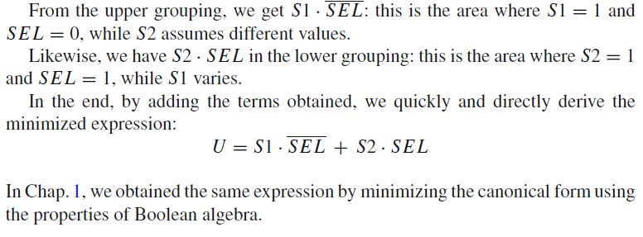
00
01
11
10
0
1
00
01
11
10

Slide 31
